Slide 1
Mathematics (9-1) - iGCSE
2018-20
Year 09
Unit 12 – Answers

Slide 2
12 - Prior knowledge check
Page 672
a. 1.5 b. 6.4
a. 36 b. 3 c. f d. 8 e. 4 f. $\frac{3}{2}$
a. $\frac{2}{3}$ b. $\frac{1}{5}$
a. x = $\frac{4}{3}$ = 1$\frac{1}{3}$ b. x = $\frac{32}{3}$ = 10$\frac{2}{3}$
C and G
a. 2 b. $\frac{1}{2}$
a. 24cm b. 20cm²

Slide 3
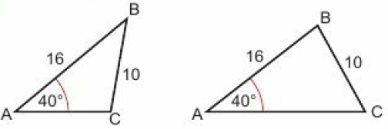
12 - Prior knowledge check
Page 672
a. p = r, q = s (vertically opposite) b. u = w, t = v (corresponding angles)
Accurate construction of the triangle. (if correct, angle between 6 cm line and 8 cm line will be 90⁰.)
Accurate constructions of the triangles

Slide 4
12.1 - Congruence
Page 672
a. A and D; C and F
a. = 134° (vertically opposite); b = 134° (alternate with 134⁰); c = 46° (angles on a straight line)
12cm
a. 112° b. 5cm
a. SAS b. RHS c. SSS d. AAS e. AAS

Slide 5
12.1 - Congruence
Page 672
a. Congruent, SAS. A corresponds to R, B corresponds to Q, C corresponds to R b. Not congruent
DEF (SSS) and GHI (SAS)
Yes, congruent, SSS (using Pythagoras to find the missing sides)

Slide 6
12.1 - Congruence
Page 672
No. All the triangles with a 12cm hypotenuse will be congruent, and all the triangles where 12cm is not the hypotenuse will be congruent.
a. ∠EBA = 50°, ∠EAB = 20°, ∠EDC = 20°, ∠CED = 110°
Two angles and a corresponding side are equal (AAS).
a. 119° b. 119° c. 35°
Suitable proof, e.g. Two angles and a corresponding side are equal (AAS), so JKL and JML are congruent.

Slide 7
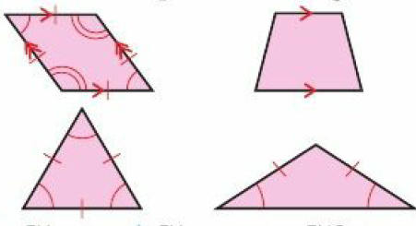
12.2 – Geometric Proof & Congruence
Page 672
a. EM b. FM c. ∠EMG
a. Suitable proof, e.g. ∠WXT = ∠WZY = 90°; WY is common (hypotenuse); WZ = XY. Therefore the triangles are congruent (RHS).
∠WYZ

Slide 8
12.2 – Geometric Proof & Congruence
Page 672
a. Suitable proof, e.g. SQ is common; PQ = SR; PS = QR. Therefore the triangles are congruent (SSS). b. i. 123° ii. 28.5°
Suitable proof, eg. LX = XM; XK = XL; ∠JXK = ∠LXM (vertically opposite). Therefore the triangles are congruent (SAS).
Suitable proof, e.g. ABCD is a rhombus, so ∠ABC = ∠ADC, BA = AD and BC = CD. Therefore the triangles are congruent (SAS).

Slide 9
12.2 – Geometric Proof & Congruence
Page 673
a. FG = GH; EG is common; ∠FEG = ∠GEH = 90°. Therefore the triangles are congruent (RHS).
If the triangles are congruent, then FE = EH, therefore FE = $\frac{1}{2}$FH.
SM is common, RS = ST; ∠SMR = ∠SMT = 90°. Therefore triangles RSM and MST are congruent (RHS). If the triangles are congruent, then RM and MT are the same length and the line SM bisects the base.

Slide 10
12.2 – Geometric Proof & Congruence
Page 673
PQ = ST; ∠QPR = ∠RTS (alternate); ∠PQR = ∠RST (alternate). Therefore triangles PQR and RST are congruent (AAS). If the triangles are congruent, then PR = RT and R is the midpoint for PT.

Slide 11
12.2 – Geometric Proof & Congruence
Page 673
a. Suitable proof, e.g. ∠GDE = ∠GFC (alternate); DE = CF; ∠DEG = ∠FCG (alternate). Therefore triangles DEG and CFG are congruent (AAS).
Suitable proof, e.g. ∠DCG = ∠GEF (alternate); ∠GDC = ∠GFE (alternate); DC = EF. Therefore triangles CDG and EFG are congruent (AAS).
Triangles DEG and CFG are congruent, so DG = FG. Triangles CDG and EFG are congruent, so CG = GE. Therefore G is the midpoint of CE and DF.

Slide 12
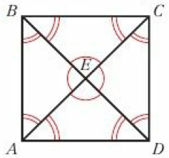
12.2 – Geometric Proof & Congruence
Page 673
a, b,
BEC, CED, DEA and AEB are congruent. BCD, ACD, ABD and ABC are congruent,
They are all equal, therefore they are all 90c.
Since all 4 triangles are congruent, AE = EC and BE = ED, therefore E is the midpoint of both AC and BD.

Slide 13
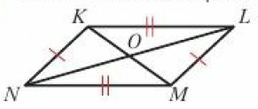
12.2 – Geometric Proof & Congruence
Page 673
Suitable proof, e.g. ∠NKO = ∠MLO (alternate angles); ∠KNO = ∠MPK (alternate angles); LM = KN. Therefore triangles KON and LMO are congruent (AAS). ∠OKL = ∠OMN (alternate angles); ∠KLO = ∠ONM (alternate angles); KL = NM. Therefore triangles OMN and KOL are congruent (AAS). Since the triangles are congruent, KO = MO, NO = LO, so O is the midpoint of both diagonals.
XY = XZ (XYZ is isosceles); XA = XB; ∠BXA is common. Therefore triangle XBY and XAZ are congruent (SAS).

Slide 14
12.3 – Similarity
Page 673
a. 2 b. $\frac{1}{2}$
PQ and XY, PR and XZ, QR and YZ
a. PQ = 1.5cm; XY = 3tm; PR = 1.9cm; XZ = 3.8cm; QR = 1.6cm; YZ = 3.2cm ∠QPR = ∠YXZ = 54°; ∠PQR = ∠XYZ = 76°; ∠QRP = ∠YZX = 50°
All are $\frac{1}{2}$.

Slide 15
12.3 – Similarity
Page 673
a. i. TU ii. UV b. $\frac{4}{9}$ c. $\frac{5}{12}$
The ratios of corresponding sides are not the same, therefore the parallelograms are not similar.
a. $\frac{10.5}{7}$ = $\frac{3}{2}$ b. $\frac{FG}{BA}$ = $\frac{6}{4}$ = $\frac{3}{2}$
Yes; the ratios of corresponding sides are the same.
a. Similar b. Similar c. Not similar

Slide 16
12.3 – Similarity
Page 673
∠DCB = ∠YXW = 155°. All the angles are the same, therefore the shapes are similar.
55 cm
20cm
10 m
a. The corresponding angles are all equal.
5cm
All right-angled triangles with one other angle the same are similar,
0.5 e. sine

Slide 17
12.3 – Similarity
Page 673
14cm
a. 6cm b. 2.8 m
a. Yes; corresponding sides are all in the same ratio,
No; corresponding sides are not in the same ratio.
a. Each shape has 6 equal sides and 6 equal angles, so they are similar,
Yes
a. 12.7 cm b. 17.7 cm

Slide 18
12.4 – More Similarity
Page 673
a. 2 b. $\frac{1}{2}$
a. ∠EDC = EBA (alternate); ∠DCE = ∠EAB (alternate); ∠CED = ∠AEB (vertically opposite). Therefore all angles are equal and the triangles are similar.
a. ∠RPQ = ∠RTS (alternate); ∠PQR = ∠RST (alternate);
∠PRQ = ∠SRT (vertically opposite). Therefore all angles are equal and the triangles are similar.

Slide 19
12.4 – More Similarity
Page 673
a. ∠F is common; ∠FGH = ∠FJK (corresponding); ∠FHG = ∠FKJ (corresponding). Therefore all angles are equal and the triangles are similar. b. 60 mm c 64 mm
a. ∠PQN = 52°; ∠LMN = 102° b. ∠L is common; ∠MNL = ∠PQN (corresponding);
∠LMN = ∠MPQ (corresponding). Therefore all angles are equal and the triangles are similar,
44cm d. 22cm e. 18cm

Slide 20
12.4 – More Similarity
Page 673
Perimeter = 54 m; area = 135m²
28,800cm²
Perimeter = 5cm; area = 2.1 cm²
a. 18cm b. 7.5cm
5cm
a. 24cm² b. 54cm²
12 cm, 15 cm, 19.2 cm
a. 4 b. 2 c. 21cm
30cm

Slide 21
12.5 – Similarity in 3D Solids
Page 673
a. 5 b. 4
1500cm³
96cm³
405cm³
60cm³
Linear Scale Factor | Volume A | Volume B | Volume Scale Factor
2 | 2 | 16 | 8
k | 24 | 24k³ | k³

Slide 22
12.5 – Similarity in 3D Solids
Page 673
7.5cm
a. 21cm b. 6cm
a. 125 b. 5 c. 25 d. 1500cm²
563cm²
4220cm²

Slide 23
12.5 – Similarity in 3D Solids
Page 673
Area scale factor = $\frac{92}{207}$ = $\frac{4}{9}$. So linear scale factor = $\frac{2}{3}$ and volume scale factor = $\frac{8}{27}$. Volume of cone B = 837 x $\frac{8}{27}$ = 248 cm³
a. 640 cm³ b. 40 cm²
8.44 litres
All lengths in a cube are the same, so all cubes have sides in the same ratio. Cuboids may vary.

Slide 24
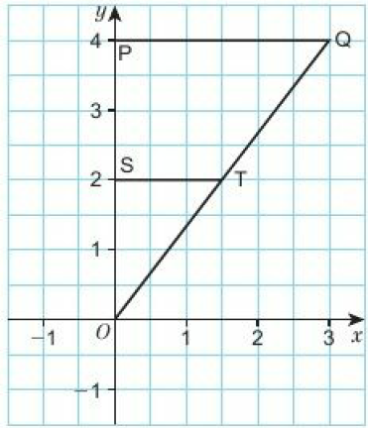
12 – Problem Solving
Page 674
$\frac{PQ}{ST}$ = $\frac{OP}{OS}$ = $\frac{OQ}{OT}$ = 2. All corresponding sides are in the same ratio, therefore, triangles OPQ and OST are similar.

Slide 25
12 – Problem Solving
Page 674
7.2 m
1m
a. 60
Proof using SSS or SAS that the triangles are congruent.
Interior angles of triangle are 84°, 48° and 48°. Two angles are equal, so the triangle is isosceles.
An 8m ladder reaching a 7.8m high gutter wouId be 1.77 m (2 d.p.) away from the base of the wall. The 4 in 1 rule requires it to be 1.95 m away.

Slide 26
12 – Check Up
Page 674
A and C are congruent (SAS)
a. b. Suitable proof using any of SSS, SAS, RHS, e.g. ∠JHK = ∠HKL; ∠JKH = ∠LHK; HK is common. Therefore the triangles are congruent (AAS).
a. All corresponding sides are in the same ratio (scale factor 2)
Missing angles are 58° and 35°, therefore all angles are equal and the triangles are similar.

Slide 27
12 – Check Up
Page 674
a. 20cm b. 18cm
a. ∠A is common; ∠EBA = ∠DCA (corresponding); ∠EDC = ∠AEB (corresponding). All angles are equal so the triangles are similar,
CD = 32cm
a. ∠PQR = ∠RST (alternate); ∠QPR = ∠RTS (alternate); ∠PRQ = ∠SRT (vertically opposite). All angles are equal so the triangles are similar,
x = 40 cm; y = 19.5 cm

Slide 28
12 – Check Up
Page 674
Area = 200cm²; perimeter = 55.2cm
2580.5 cm³
519cm³
Right-angled triangles with an angle of 45° are similar, and tan 45 = 1 Right-angled triangles with an angle of 60° are similar, and cos 60 = 0.5

Slide 29
12 – Strengthen
Page 674
Congruence
D
A and C
Rectangle, parallelogram (x2 ways), kite, isoscles triangle (x2 ways)
a. SSS b. RHS c. AAS
a. Suitable proof, e.g. KM is common, LM = NM, KN = KL. Therefore the triangles are congruent (SSS).
LN is common but the other sides do not correspond.

Slide 30
12 – Strengthen
Page 674
Similarity in 2D shapes
a. i. AB and ED, DF and BC, AC and EF
∠ABC = ∠EDF, ∠ACB = ∠EFD, ∠CAB = ∠FED
i. IK and IJ, Gl and HI, GK and HJ ii. ∠lJH = ∠lKG, ∠KIG = ∠JIH, ∠lHJ = ∠IGK
i. LM and OP, MN and PQ, LN and OQ ii. ∠OPQ = ∠LMN, ∠POQ = ∠MLN, ∠PQO = MNL
i. SR and WU, ST and WT, RT and UT ii. ∠RST = ∠UWT, ∠SRT = ∠WUT, ∠STR = ∠WTU

Slide 31
12 – Strengthen
Page 674
a. c. x = 10, y = 4
1.5 cm
a = 4cm, b = 20cm, c = 12cm, d = 6cm
C and E
C | D | $$\frac{C}{D}$$
3 | 6 | $$\frac{1}{2}$$
5 | x | $$\frac{5}{x}$$
y | 8 | $$\frac{y}{8}$$

Slide 32
12 – Strengthen
Page 674
a. i. Alternate angles ii. Alternate angles iii. Vertically opposite angles
The triangles are similar,
The paired angles are the same size,
x = 10cm, y= 11cm

Slide 33
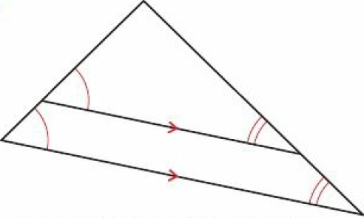
12 – Strengthen
Page 674
a.
∠ACB = ∠AED (corresponding); ∠ABC = ∠ADE (corresponding); ∠CAB = ∠EAD (angle is common) All three angles are equal, so the triangles are similar.
Students‘ sketches,
Scale factor = $\frac{5}{4}$. BD = 13cm, ED = 80cm

Slide 34
12 – Strengthen
Page 674
a. Drawing of rectangle A (2 by 5) b. Drawing of rectangle B (4 by 10) c. Perimeter of A = 14, perimeter of B = 28 d. Scale factor is 2. e. Drawings of rectangle C (6 by 15) f. 42
a. 5 b. 60cm
Scale factor is 4 = 2²
150 cm².

Slide 35
12 – Strengthen
Page 674
Similarity in 3D solids
a. 8 b. Scale factor is 8 = 23 c. 3 d. Scale factor is 27 = 33 e. Students‘ own answers
a. 9 b. 3 c. 27 d. 337.5cm³

Slide 36
12 – Extend
Page 674
a. Students‘ drawings b. 20cm
a. ∠JAK = ∠BAC (angle is common); ∠AKJ = ∠ACB; ∠AJK = ∠ABC (from sum of angles in triangle = 180°). All three angles are the same, so the triangles are similar,
18cm c. 5.4cm
1.5cm²

Slide 37
12 – Extend
Page 675
41cm
675cm²
53.76 kg
1.5cm
a. 13,291.25 cm³ b. 75

Slide 38
12 – Extend
Page 675
Suitable proof, e.g. AEB is isosceles (AE = BE) therefore ∠EAB = ∠EBA. By alternate angles, ∠EAB = ∠ECD and ∠EBA = ∠EDC so triangle CDE is isosceles. So AC = BD (corresponding lengths are the same) By alternate angles, ∠AGF = ∠FDC and ∠BHJ = ∠JCD, so ∠FDE = ∠JCE. Therefore, by AAS, we know that triangles ACH and BDG are congruent.

Slide 39
12 – Extend
Page 675
30.8cm
a. 18cm b. 1350πcm³ c. 400πcm³ d. 950π = 2980cm³ to 3 s.f.
3500 cm³
AD = AB and AE = AG; ∠EAB = ∠DAG = 90° + ∠DAE. Therefore the triangles are congruent (SAS).

Slide 40
12 – Extend
Page 675
Linear scale factor = $\frac{(x2 −1)}{2(x −1)}$ = $\frac{(x+1)(x −1)}{2(x −1)}$ = $\frac{x+1}{2}$ Area scale factor = ($\frac{x+1}{x}$)² Area of B = 8 x $(\frac{x+1}{2}$)² = $\frac{8(x2 + 2x + 1)}{4}$ = 2x² + 4x + 2

Slide 41
12 – Unit Test
Page 675
Sample student answer
Drawing the relevant triangles next to each other, the same way up, makes it easier to match the corresponding angles to see if they are the same. It also avoids confusion with the other parts of the diagram.
The student has explained each step of the answer clearly and separately to show how each angle was calculated, and has summarised a final proof statement.

